Slide 1
Carbon Monitoring sys·tem
ˈsistəm/
noun
1. a set of connected things or parts forming a complex whole, in particular.
a set of things working together as parts of a mechanism or an interconnecting network
2. a set of principles or procedures according to which something is done; an organized scheme or method.

Slide 2
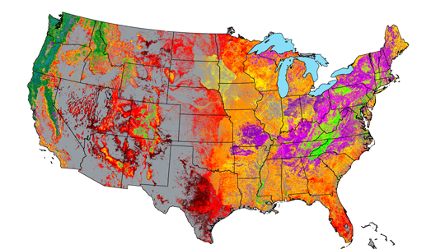
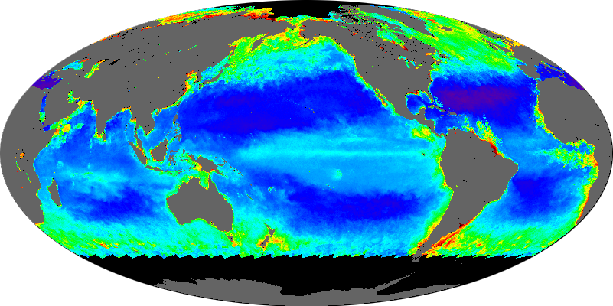
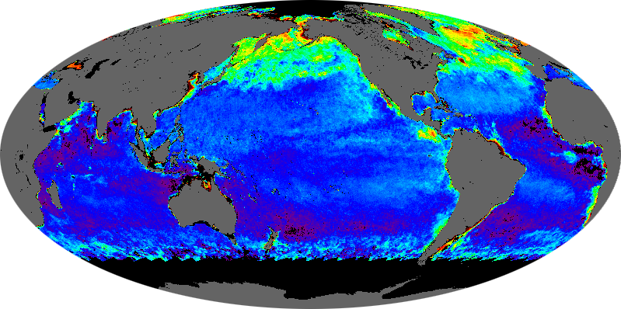
NASA-CMS Phase 1 Examples
Notes:
Biomass National Pilot- Saatchi et al. 250m biomass map.
Biomass Local- Cook, Dubayah, Hurtt et al. 90m biomass map and c sequestration estimates for 2 counties in MD.
Flux-Pawson et al., system diagram
Oceans- Behrenfeld et al. Study to address link between chi and b

Slide 3

Gridded Mass Balance
One pool,
Multiple fluxes (j)
ΔStock=Σ(Flux_{j})
e.g. Global atmospheric
Carbon budget
Multiple pools (i),
Mulitple fluxes (j)
ΔStock_{i}=Σ(Flux_{i,j})
e.g. atmoshere, land,
Ocean, etc.
Multiple pools (i),
Multiple fluxes (j),
Gridded (k)
ΔStock_{i,k}=Σ(Flux_{i,j,k})
e.g. Potential NASA-CMS
-> Overlay relevant NASA products
And uncertainties
-> i.d. capabilities, strengths, gaps
-> match/optimize to user needs

Slide 4







NASA-CMS Phase 2
Award year: # of projects (decision support / MRV)
2012: 20
2013: 17
Global Surface-Atmosphere Flux
2012: 2
Land-Atmosphere Flux
2012: 6 (5/1)
2013: 8 (6/4)
Ocean-Atmosphere Flux
2012: 1
Land Biomass
2012: 7 (5/2)
2013: 9 (9/8)
Ocean Biomass
2012: 3
Land-Ocean Flux
2012: 1

Slide 5
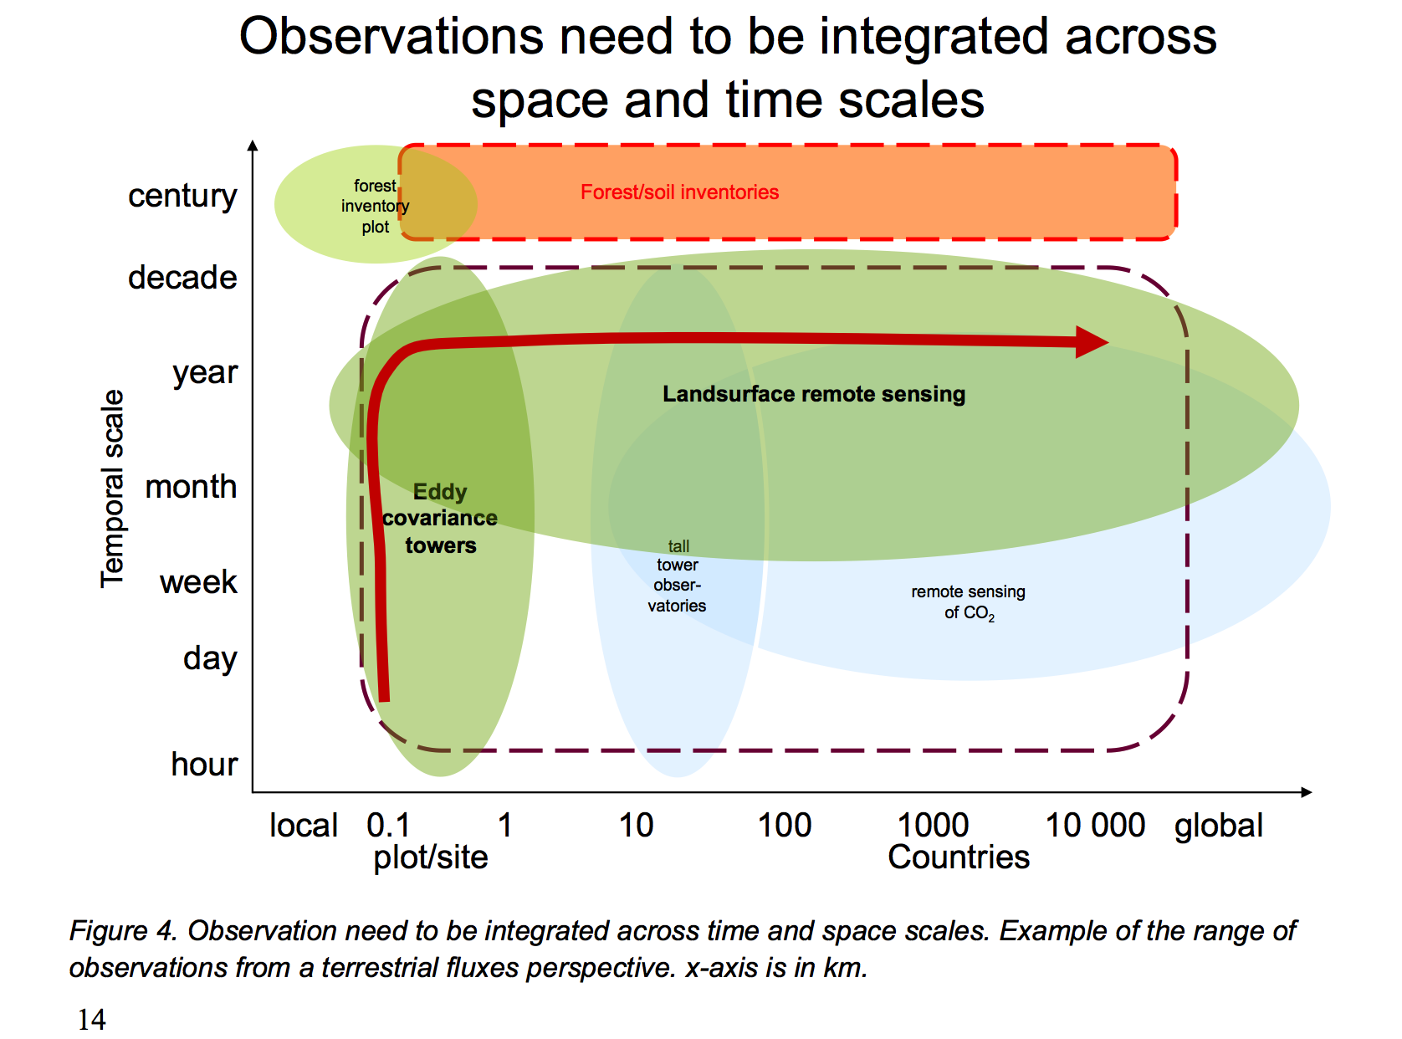
Observation scale
GEO-Carbon Strategy, 2010

Slide 6
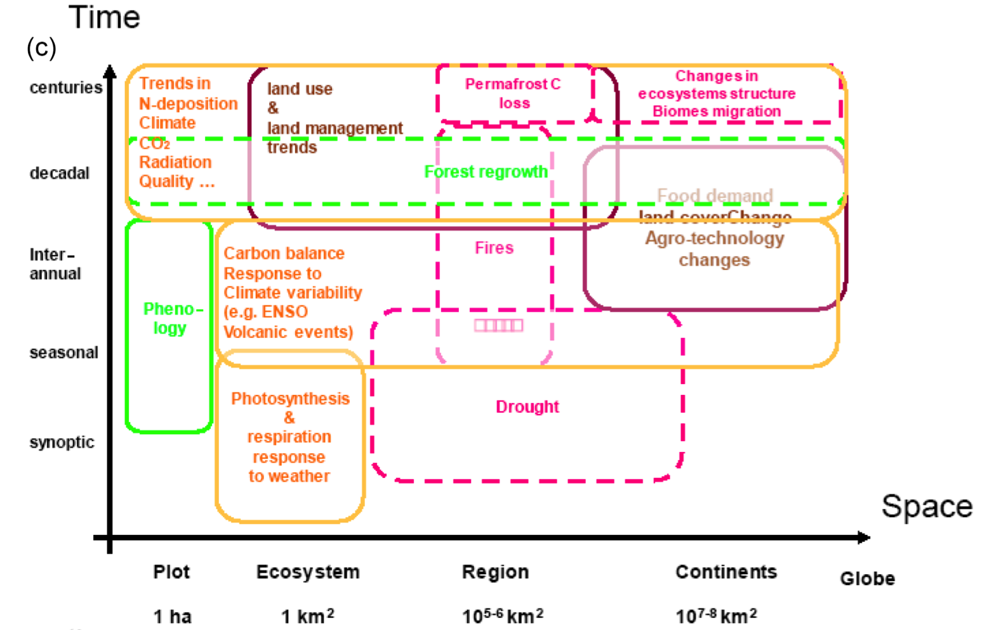
Process scale
Ciais et al, GBC, 2014

Slide 7
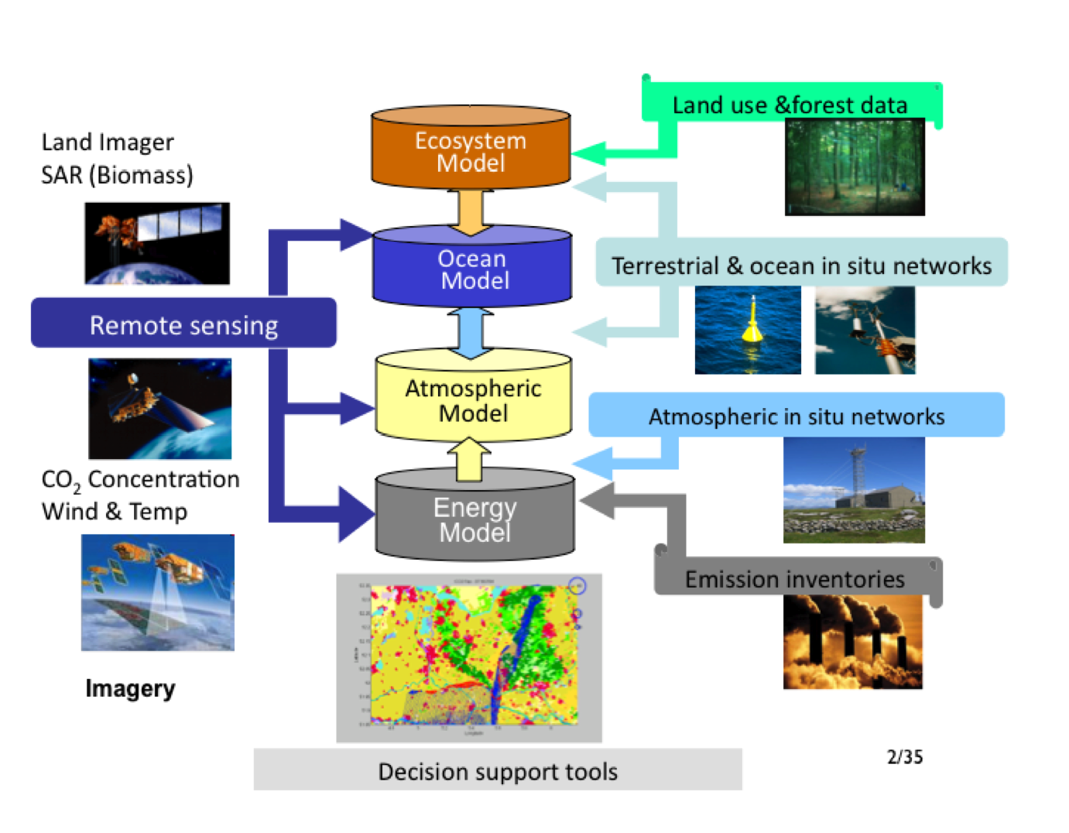
Integration
CMS activities (esp. GEO-CARB and CMS-Flux) have made activities have made significant advances in Carbon Cycle Data Assimilation Systems (CCDAS) recommended in the GEO-Carbon strategy.
CCDAS prefer consistent spatial
and temporal scales.
How to integrate across such diverse scales?
Do we need a multi-scale CCDAS?
GEO-Carbon Strategy, 2010

Slide 8
Towards a CMS: two approaches
“Bottom-up”
  Find “systems-of-opportunity” that build collaborations leveraging existing projects
  Find projects that are performing complimentary activities
“Top-down”
  Review national and international documents related to CMS, e.g., GEO-Carbon Strategy.
    Assess relevance to CMS
  Assess requirements from current and potential users
  Recommend steps to build CMS framework(s)

